Slide 1
Goodreads Data Analysis
using Spark, Airflow, and Docker
Mariana Kambey

Slide 2
Outline
Overview Project
Main Project

Slide 3
Overview Project

Slide 4
Overview
Outcomes:
- The project has successfully implemented Docker, Apache Airflow, Apache Spark to process the Goodreads data efficiently.
Based on the Analysis the outcomes are :
- Generate valuable insights into reading trends, including the most reviewed books, top rated books, most rated books. -The project enhances the reading experience for users, helping readers discover books aligned with readers preferences.
-The analysis offers actionable recommendations for authors and publishers, helping them understand audience preferences and market dynamics.
Technologies Used: Docker for containerized architecture, Apache Airflow for data workflow orchestration and Apache Spark for processing the Goodreads data.
Project Title : Goodreads Data Analysis using Spark, Airflow, and Docker.
Project Goal : To efficiently process Goodreads data to uncover meaningful insights and gives actionable recommendations to various stakeholders.
Analysis : Top-rated books per year, Most-reviewed books per year, Most-rated books per year. Correlation between Average Rating and Number of Pages and Correlation between Average Rating and Publication Year.

Slide 5
Main Project

Slide 6
Project Background
Project Title : Goodreads Data Analysis using Spark, Airflow, and Docker.
The purpose of this project is to efficiently process Goodreads data to uncover meaningful insights and gives actionable recommendations to various stakeholders.

Slide 7
2. Problem Statement
This project addresses the challenge of efficiently processing Goodreads data to uncover meaningful insights and actionable recommendations.
To achieve this, It is necessary to implement a containerized architecture using Docker, Orchestration the data workflow with Apache Airflow, and utilize Apache Spark for efficient data (Goodreads Data) processing.
The project will focus on calculating specific metrics to derive insights from the data gives actionable recommendations to various stakeholders, including:
Top-rated books per year.
Most-reviewed books per year.
Most-rated books per year.
Correlation Analysis, specifically:
- Correlation between Average Rating and Number of Pages.
- Correlation between Average Rating and Publication Year.

Slide 8
3. Data Platform Understanding
This project employs a robust containerized architecture using Docker, ensuring consistent deployment across environments and minimizing compatibility issues.
The data workflow is orchestrated with Apache Airflow, which manages scheduling, monitoring, and execution of tasks in the processing pipeline.
Data Ingestion and Storage: Data is sourced from CSV files containing various book attributes from Goodreads. After extraction, it is processed and cleaned with Apache Spark, then stored in a PostgreSQL database.
Orchestration with Airflow: Apache Airflow, running in its own Docker container, schedules and manages the data pipeline, from extraction to storage. Its DAG structure clearly represents workflows and dependencies, enhancing maintainability and scalability.
Data Processing with Spark: Apache Spark is the core engine for efficiently processing and cleaning data. Its distributed computing capabilities enable parallel processing of large datasets.

Slide 9
4. Data Understanding
Goodreads book dataset is sourced from Kaggle: (https://www.kaggle.com/datasets/jealousleopard/goodreadsbooks)
Size : 1.56 mb Number of rows : 11127
Number of columns : 12
The dataset comprises various attributes related to books, sourced from Goodreads CSV files.
Key fields in the dataset include:
BookID: Unique identifier for each book.
Title: The title of the book.
Authors: The authors of the book.
Average Rating: The average rating given by users.
ISBN : A 10-digit unique identifier for books.
ISBN13 : A 13-digit updated version of ISBN for global use.
Language Code : A standardized code indicating the book's language.
Number of Pages: The total pages in the book.
Ratings Count: The total number of ratings received.
Text Reviews Count: The number of text reviews provided by users.
Publication Date: The date the book was published.
Publisher: The publisher of the book.

Slide 10
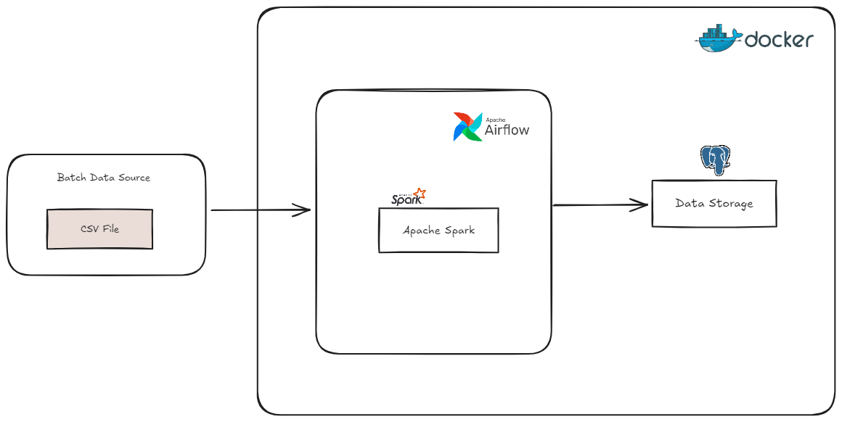
5. Project Architecture
The data processing pipeline was designed to handle batch processing.
The architecture includes : - Docker for containerized architecture.
- Apache Airflow for data workflow orchestration.
- Data Ingestion, loading the CSV file into Apache Spark.
- Processing the data using Apache Spark.
- Data Output, writing the transformed data to PostgreSQL for storage.

Slide 11
5. Transformation
Apache Spark was selected as the core data processing tool because it excels in large-scale distributed data processing. Transformations included:
Drop irrelevant columns for analysis such as isbn and isbn13.
Filtering invalid records, such as those with non-numeric average_rating or missing ratings_count.
Creating new features such as publication_year by extracting it from the publication_date column.
Standardizing string fields ( title, authors, and publisher) to ensure consistency and facilitate comparison.
The transformed data was cached then used for various analyses, such as calculating correlations and ranking books.

Slide 12
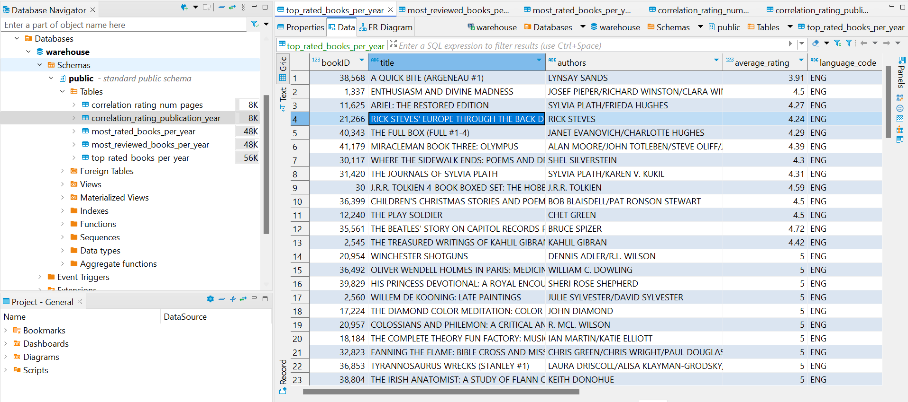
6. Data Modelling (Business)
The business logic for the project focused on creating tables that serve specific analytical purposes, such as:
1. Top-rated books per year
2. Most-reviewed books per year
3. Most-rated books per year
4. Correlation Analysis: A table summarizing the correlation coefficients between various numerical attributes in the dataset, specifically:
- Correlation between Average Rating and Number of Pages.
- Correlation between Average Rating and Publication Year.

Slide 13
7. Conclusion & Recommendation
Conclusion
- The project has successfully implemented Docker, Apache Airflow, Apache Spark to process the Goodreads data efficiently.
Based on the Analysis the outcomes are :
- Generate valuable insights into reading trends, including the most reviewed books, top rated books, most rated books.
-The project enhances the reading experience for users, helping readers discover books aligned with readers preferences
-The analysis offers actionable recommendations for authors and publishers, helping them understand audience preferences and market dynamics.
Recommendations
Scalability for real-time analytics, process real-time data from Goodreads.
Integrate with additional data sources, such as social media to provide deeper insights into user preferences and book trends.
Visualization tools could be used to make insights.

Slide 14
THANK YOU :)

